Slide 1

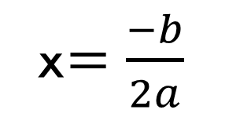

TOPIC: Solving Quadratics by completing the square
EQ: How do I complete the square?
Math Warm Up
Opposite of b
x$=\frac{−b}{2a}$
$$y=ax^{2}+bx+c$$
$$Example: y=x^{2}−4x+1$$
a =
b =
c =

Slide 2
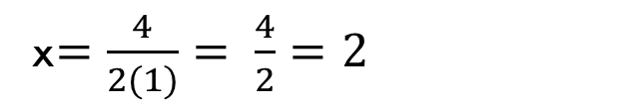
TOPIC: Solving Quadratics by completing the dquare
EQ: How do I complete the square?
Math Warm Up
Opposite of b
x$=\frac{−b}{2a}$
$$y=ax^{2}+bx+c$$
$$Example: y=x^{2}−4x+1$$
a = 1
b = -4
c = 1
x$=\frac{4}{2(1)}= \frac{4}{2}=2$
So the axis of symmetry is 2

Slide 3
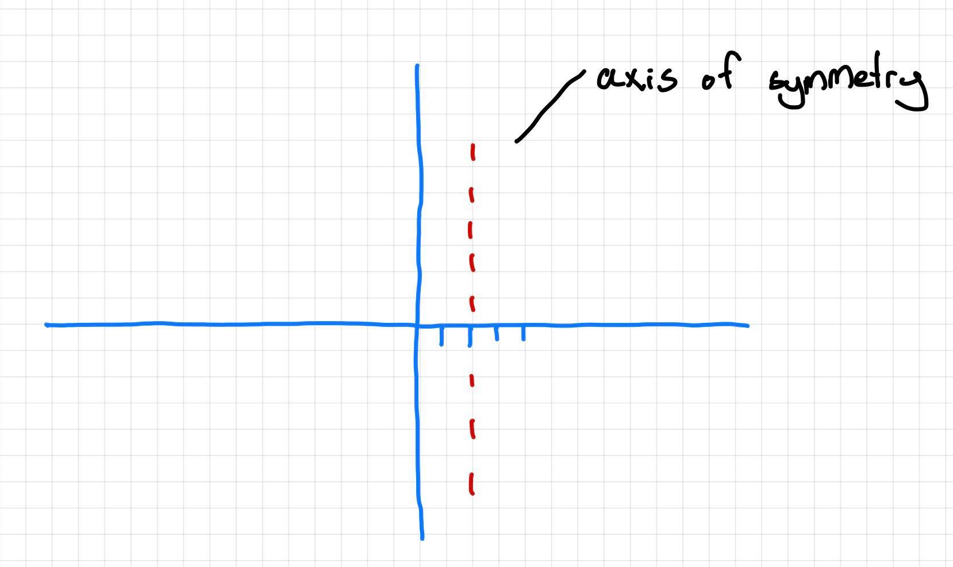
TOPIC: Solving Quadratics by completing the square
EQ: How do I complete the square?
X | 2
y
We now need to choose 2 points either to the left or to the right

Slide 4
TOPIC: Graphing Parabolas from an equation
EQ: How do I graph parabolas when I’m given a double bracket or an equation?
How do you find the y-coordinate?
X | 0 | 1 | 2
y | 1 | -2 | -3
We now know that our x coordinate is 2
To find the y-coordinate we need to substitute our x values back into the equation

Slide 5
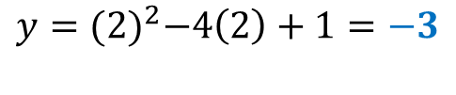
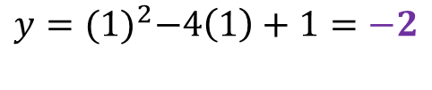
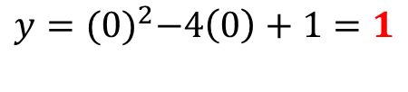
TOPIC: Graphing Parabolas from an equation
EQ: How do I graph parabolas when I’m given a double bracket or an equation?
How do you find the y-coordinate?
X | 0 | 1 | 2
y | 1 | -2 | -3
We now know that our x coordinate is -4
To find the y-coordinate we need to subsitute our x values back into the equation
$$y={(0)}^{2}−4\left(0\right)+1=1$$
$$y={(1)}^{2}−4\left(1\right)+1=−2$$
LETS PLOT THE POINTS NOW!
$$y={(2)}^{2}−4\left(2\right)+1=−3$$

Slide 6
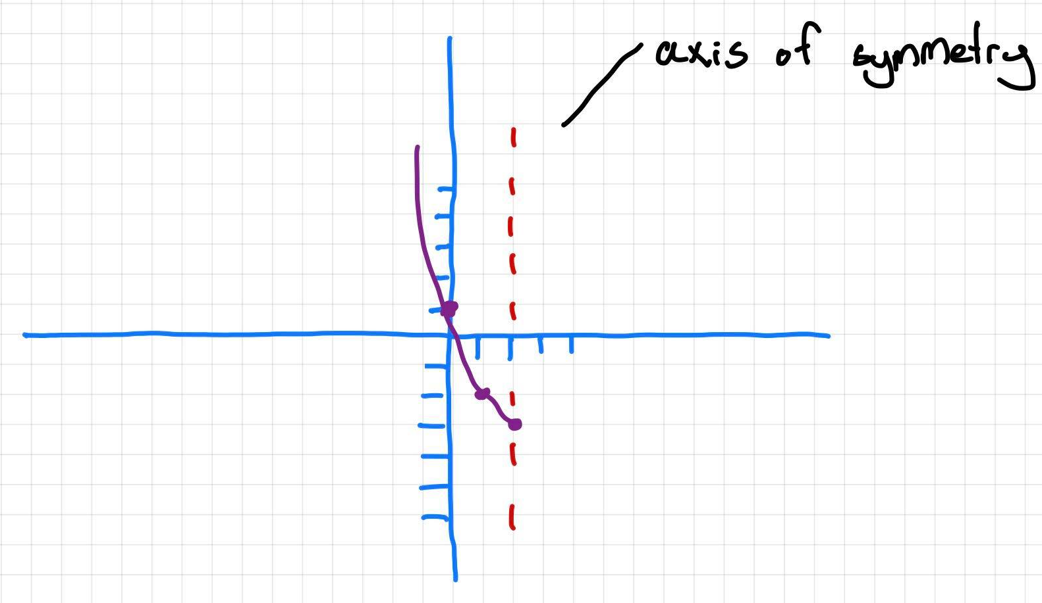
TOPIC: Solving Quadratics by completing the square
EQ: How do I complete the square?
Across 1 up 1!
Across 1 up 1!
Remember, the line of symmetry means the points are a reflection! So do the same points across from the line of symmetry!

Slide 7
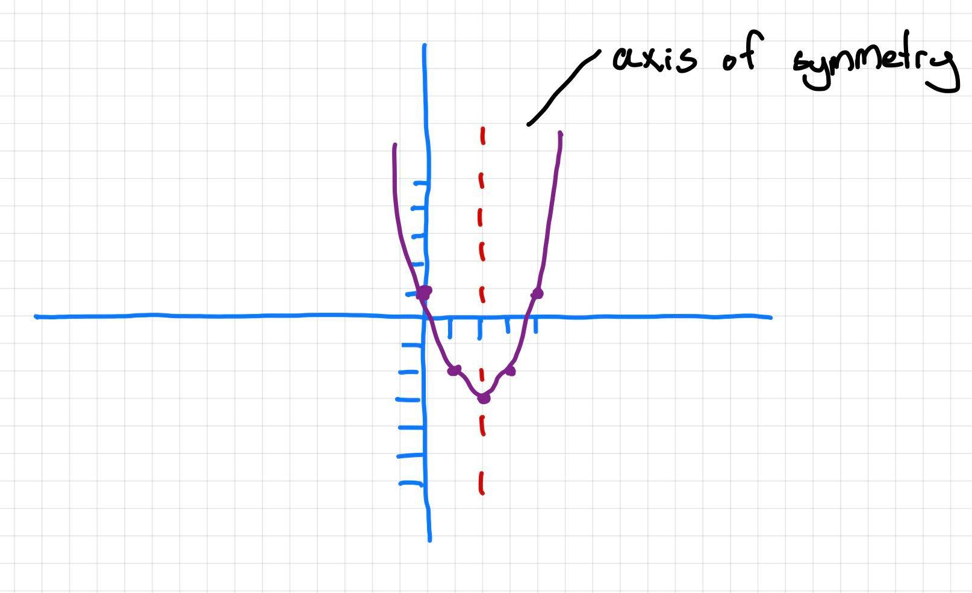
TOPIC: Solving Quadratics by completing the square
EQ: How do I complete the square?
Our parabola is a minimum one with a vertex of (2, -3)
Our Y-Intercept is (0, 1)

Slide 8
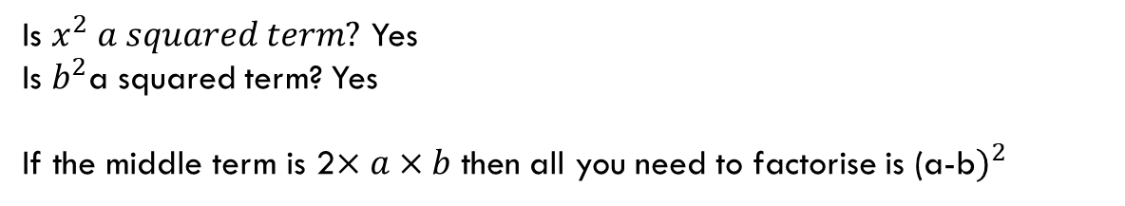

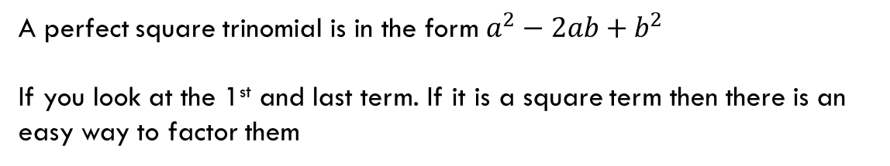
TOPIC: Solving Quadratics by completing the square
EQ: How do I complete the square?
How to factor a perfect square?
A perfect square trinomial is in the form $a^{2}−2ab+b^{2}$
If you look at the 1st and last term. If it is a square term then there is an easy way to factor them
Example:
$$x^{2}−10x+25$$
Is $x^{2} a squared term?$ Yes
Is $b^{2}$a squared term? Yes
If the middle term is 2$×a×b$ then all you need to factorise is (a-b$)^{2}$

Slide 9








TOPIC: Solving Quadratics by completing the square
EQ: How do I complete the square?
$${Formula: a}^{2}−2ab+b^{2}$$
Example:
$$x^{2}−10x+25$$
$$a^{2}=x^{2}$$
$$b^{2}=25$$
Now lets figure out what a and b are:
$${√a}^{2}={√x}^{2}$$
$${√b}^{2}=√25$$
$$a=x$$
$$b=5$$
Now, is the middle term $2×a×b?$ Yes, so therefore the factor form is:
$$(x−5)^{2}$$
Because, the equation is subtraction the factored form must also be subtraction

Slide 10








TOPIC: Solving Quadratics by completing the square
EQ: How do I complete the square?
$${Formula: a}^{2}−2ab+b^{2}$$
Try this one yourself!
$$x^{2}+12x+36$$
$$a^{2}=$$
$$b^{2}=$$
Now lets figure out what a and b are:
$$√^{}=√^{}$$
$$√^{}=√$$
$$a=$$
$$b=$$
Now, is the middle term $2×a×b?$ Yes, so therefore the factor form is:
$$(x+____)^{2}$$

Slide 11





TOPIC: Solving Quadratics by completing the square
EQ: How do I complete the square?
$${Formula: a}^{2}−2ab+b^{2}$$
Try this one yourself!
$$x^{2}+12x+36$$
$$a^{2}=x^{2}$$
$$b^{2}=36$$
Now lets figure out what a and b are:
$$√a^{2}=√x^{2}$$
$$√b^{2}=√36$$
$$a=x$$
$b=$ 6
Now, is the middle term $2×a×b?$ Yes, so therefore the factor form is:
$$(x+6)^{2}$$
Because, the equation is addition the factored form must also be addition

Slide 12




LHS:
$$x^{2}+6x+9$$
$$x^{2}−22x+121$$
$$x^{2}−14x+49$$
$$x^{2}+28x+49$$

Slide 13



TOPIC: Solving Quadratics by completing the square
EQ: How do I complete the square?
$${Formula: a}^{2}−2ab+b^{2}$$
Try this one yourself!
$$x^{2}−60x+25$$
$$a^{2}=x^{2}$$
$$b^{2}=25$$
Now lets figure out what a and b are:
$$√a^{2}=√x^{2}$$
$$√b^{2}=√25$$
$$a=x$$
$b=$ 5
Now, is the middle term $2×a×b?$ Yes, so therefore the factor form is:
$$(x−5)^{2}$$
Because, the equation is subtraction the factored form must also be subtraction

Slide 14




LHS
$$x^{2}−16x+16$$
$$x^{2}−14x+49$$
$$x^{2}−12x+4$$
$$x^{2}−20x+25$$

